Slide 1

Bank Marketing Campaign
Virtual Internship
15-Apr-2024

Slide 2
Background – Bank Marketing Campaign
ABC bank seeks to improve its marketing strategy for term deposit products by utilizing machine learning (ML) models. By predicting customers' propensity to purchase based on past interactions with banks or other financial institutions, they aim to optimize resource allocation in marketing channels such as telemarketing, SMS/email marketing, etc. Developing an ML model allows ABC Bank to identify and focus on customers with a higher likelihood of purchasing the product, thereby saving resources and reducing the time required in marketing efforts.

Slide 3
Data Understanding
21 Features
Timeframe of the data: 2008-05-05 to 2008-12-05
Total data points: 39083
Assumptions:
The datetime column is calculated based on month and day_of_week
Outliers are removed only in the age column, because they are based on assumptions about human life expectancy and outliers are human error
Categorical data is encoded using One-Hot-Encoder except for ‘y’, because ‘y’ is ordered.

Slide 4
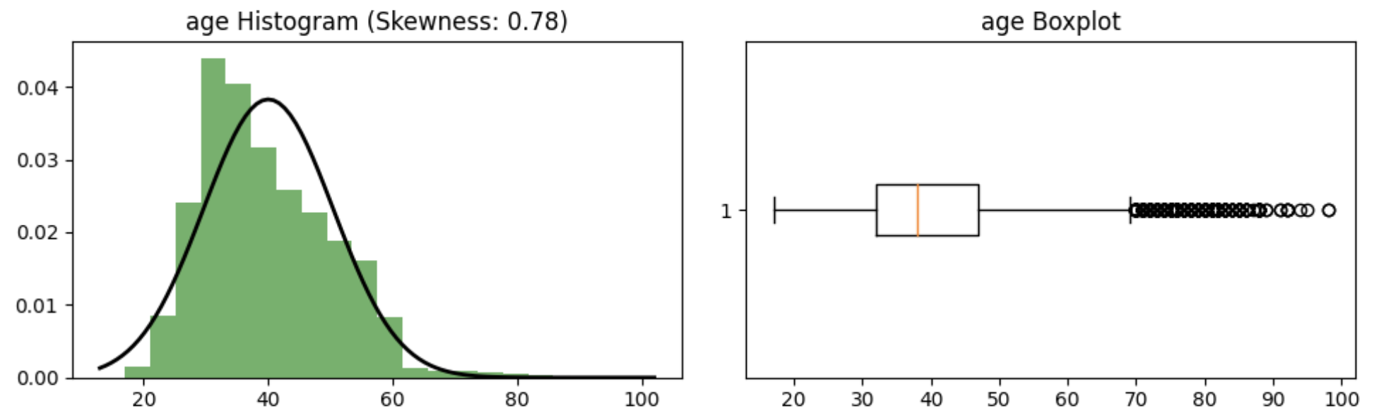
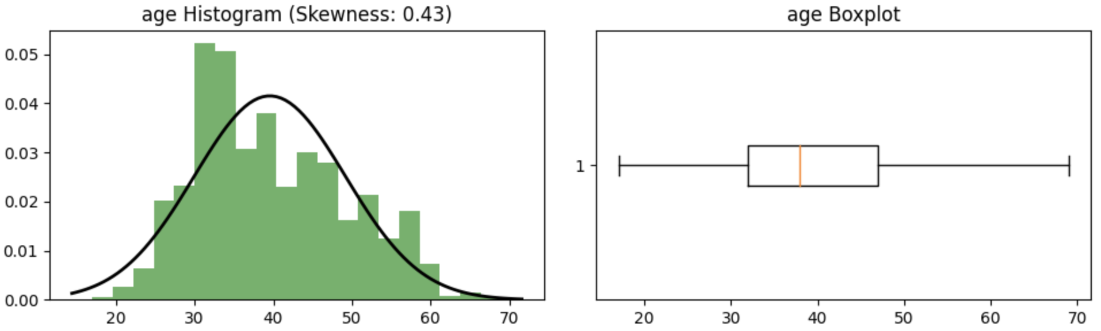
Age
The age column displays the boxplot and distribution in the image above. Assuming a human life expectancy of 70 years, values exceeding 70 are removed according to the boxplot. The image below appears improved after removing the outliers.

Slide 5
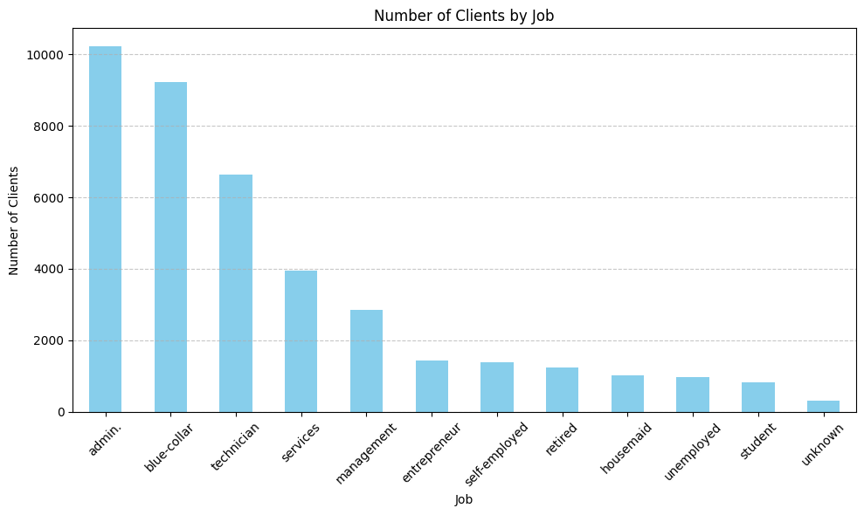
Job
The client mostly has admin jobs, followed by blue-collar and technician roles.

Slide 6
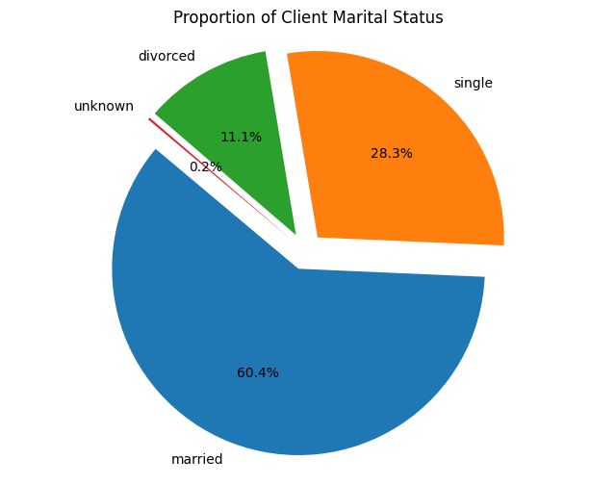
Marital
The majority of clients are married.

Slide 7
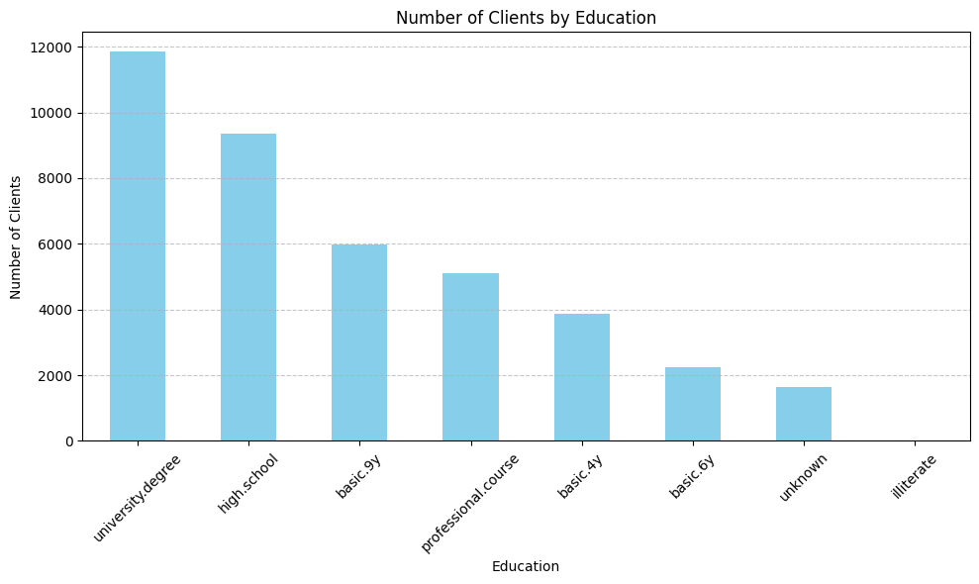
Education
The majority of clients are university graduates.

Slide 8
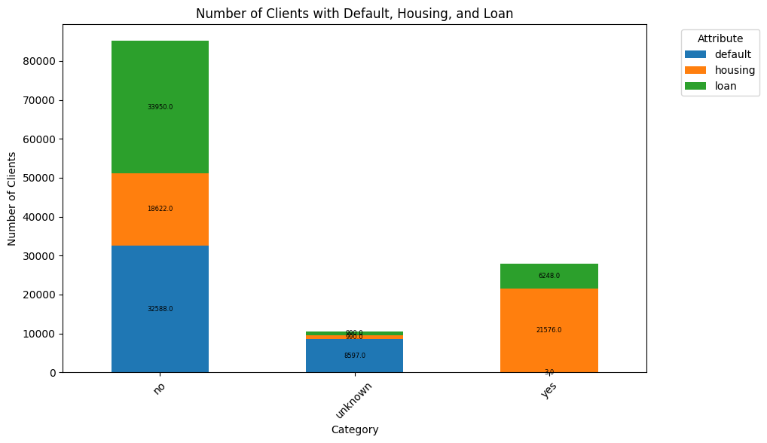
Default, Housing, Loan
The majority of clients doesn’t have credit, mortgage, or personal debt.

Slide 9
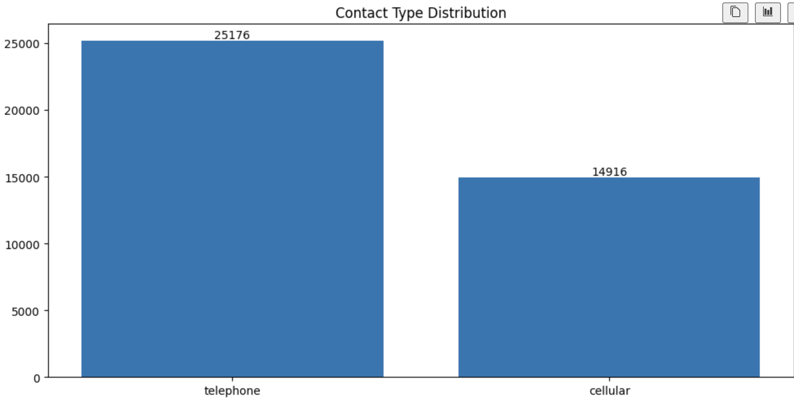
Contact, month, day of week
The majority of clients are contacted by telephone.

Slide 10
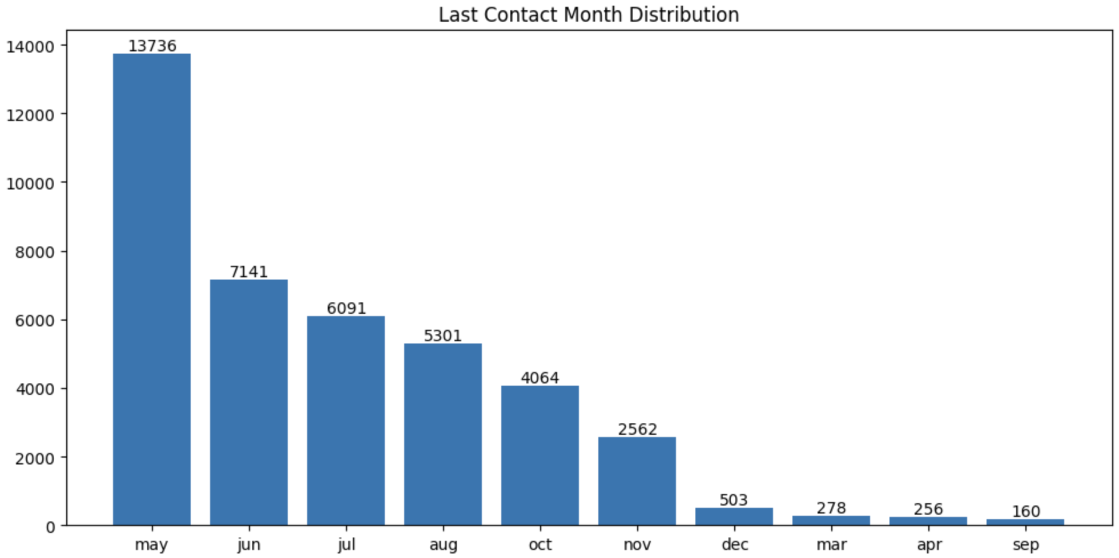
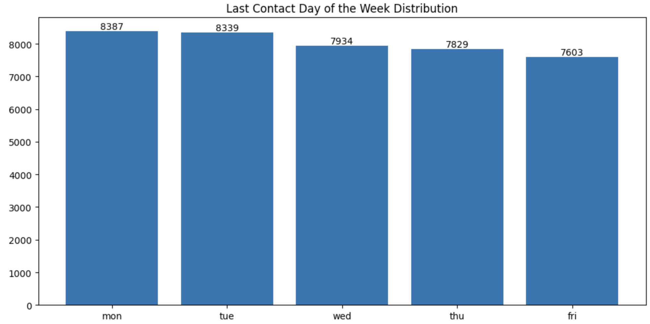
Contact, month, day of week
In the last contact, most clients were contacted in May. Regarding the days of the week, there was no significant difference.

Slide 11
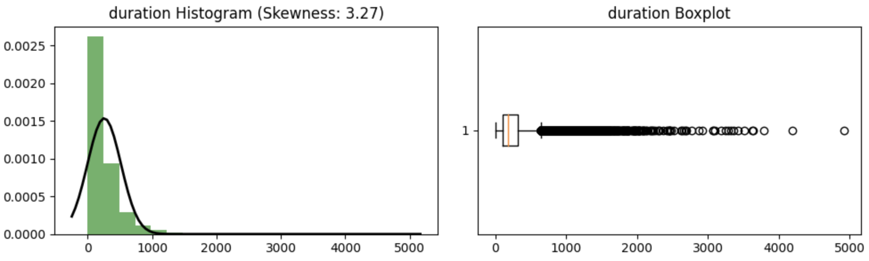
Duration
Duration is determined after the call is made. From the histogram, it is evident that many clients have not yet been contacted.

Slide 12
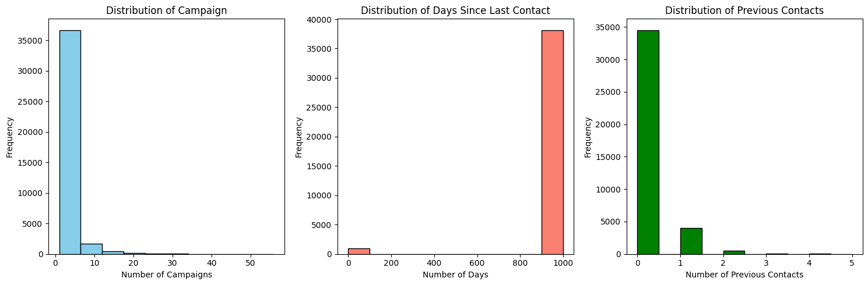
Campaign, Pdays, Previous
During this campaign, clients are contacted at most between 0 and 5 times. Many clients have not been contacted since the last contact was made, and numerous contacts had not been reached before this campaign was carried out.

Slide 13
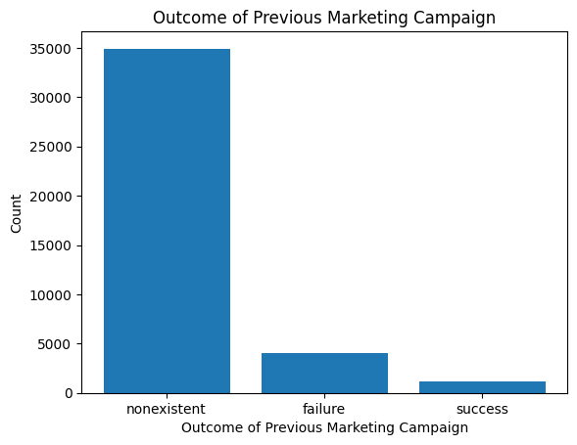
Poutcome
There have been more failures than successes in previous marketing campaigns.

Slide 14
ML Recommendations
I have encoded categorical data for all columns except 'y' because I believe the column is ordered. After analyzing the heatmap, I believe the best model for this type of data would be a decision tree or random forest model. Feature selection should also be considered so that other ensemble models like XGBoost can be utilized. The heatmap can be accessed through the following link due to its large size.

Slide 15

Thank You

